Slide 1
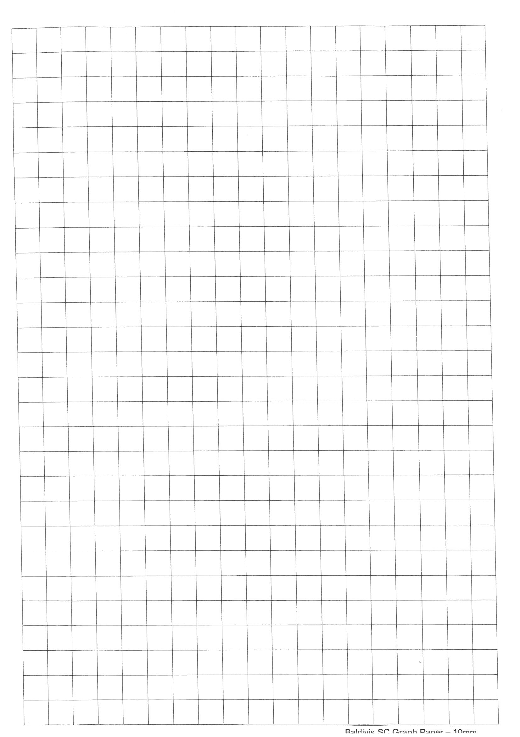
Translate each piece according to the instructions
5 down and 5 left
4 down and 9 right
10 places right
9 places left
13 places right and 4 down
11 places left and 2 down
12 places right
And 4 up
10 places left and 6 up
4 up and 1 left
5 up and 2 right
8 right and 15 up
12 places left
And 7 up
10 up and 2 right
12 up and 5 left
12 up
11 places right
17 up
15 places up

Slide 2
Translate each piece according to the instructions
5 down and 5 left
4 down and 9 right
10 places right
9 places left
13 places right and 4 down
11 places left and 2 down
12 places right
And 4 up
10 places left and 6 up
4 up and 1 left
5 up and 2 right
8 right and 15 up
12 places left
And 7 up
10 up and 2 right
12 up and 5 left
12 up
11 places right
17 up
15 places up

